Slide 1
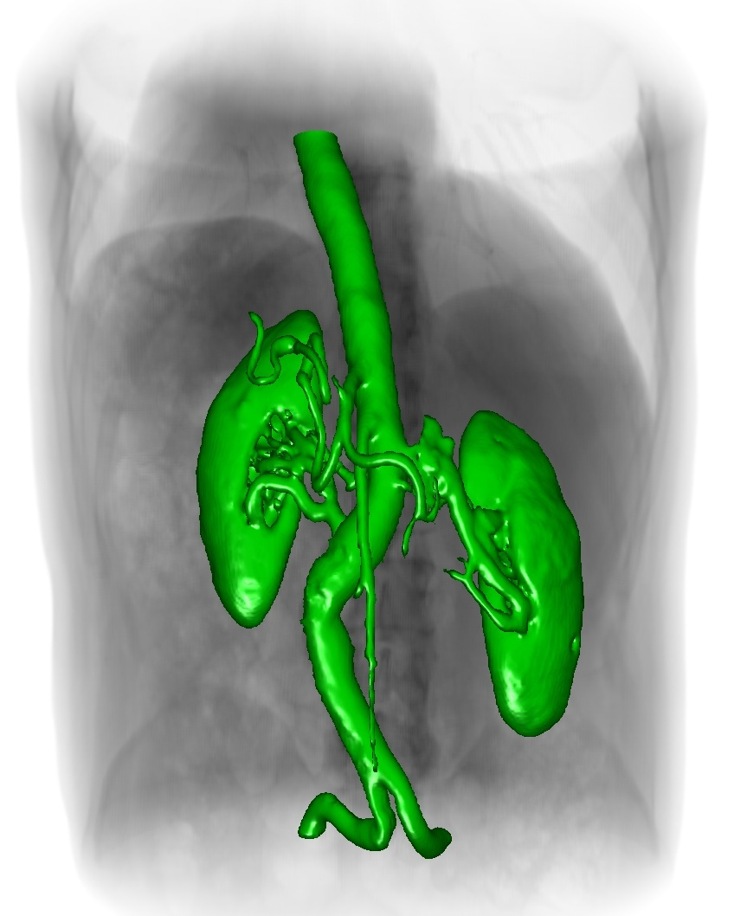

Fast Volume Segmentation with Sparse Level Sets
Mike Roberts
Notes:
Hi friends.
My name is Mike Roberts.
I’m currently a research fellow at Harvard working with Hanspeter Pfister.
During this talk, I’m going to present an overview of my master’s work on fast interactive volume segmentation with sparse level sets.
That is a bit of a mouth-full, so let’s define our terms and go over some background information.

Slide 2
What do I mean by segmentation?
Notes:
What do I mean by segmentation?

Slide 3
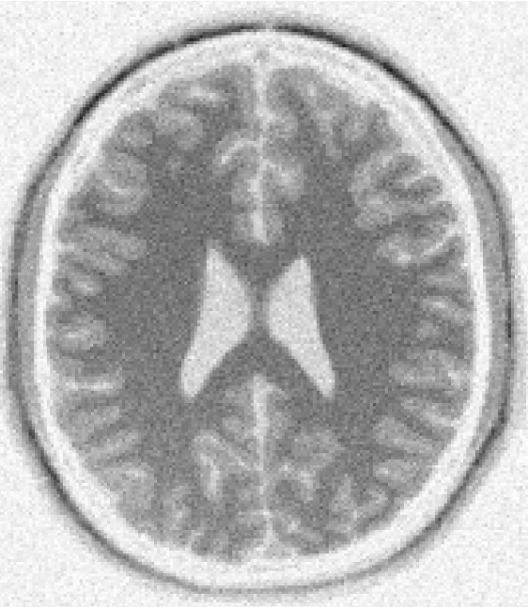
What do I mean by segmentation?
white
matter
Notes:
To illustrate what I mean by segmentation for the purposes of this discussion, consider the following MR image of a human head.
The white matter of this person’s brain is the darker interior structure shown with the arrow.

Slide 4

What do I mean by segmentation?
white
matter
Notes:
By segmenting the white matter, we partition it away from the rest of the image, as shown by the green region on the right.
Segmentation is an important task in medical imaging, because clearly if we want to accurately measure the volume of any anatomical structure in a medical image, like a brain tumor for example, we must first logically separate it from the rest of the image.
Segmentation is also an important task in computer vision.

Slide 5
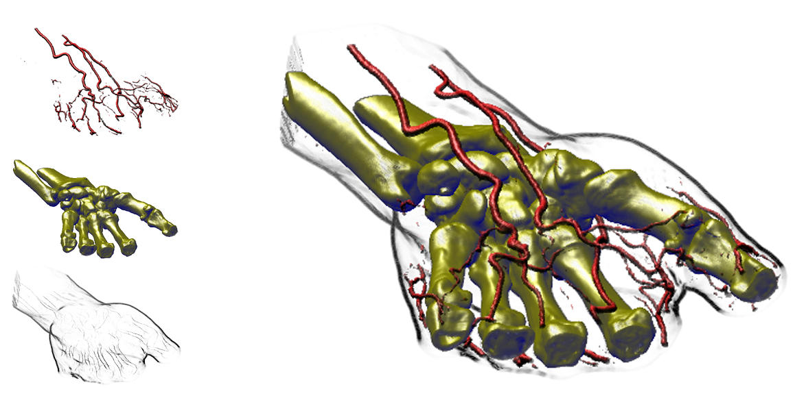
Synergy Between Segmentation and Visualization
[Hadwiger 2004]
Notes:
It’s also worth noting that, as a physician interactively explores and takes measurements of a volumetric medical data set, the tasks of visualization and segmentation complement each other. This figure demonstrates this synergy:
An initial visualization can help a physician to roughly identify regions of interest within the data set; interactive segmentation methods can precisely quantify those regions with minimal user interaction; and those segmented regions can inform the interactive visualization and subsequent exploration.
On the right we see an informative visualization of a wrist CT data set. On the left we see the segmented components that make this visualization possible.

Slide 6
Synergy Between Segmentation and Visualization
[Hadwiger 2004]
Goals: fast, interactive, accurate
Notes:
So our goal in this research is a fast, interactive, and accurate segmentation algorithm, even when the image is noisy and heterogeneous.
Medical images always have some imaging artifacts, and we want our segmentation method to cope with these artifacts.
Also, the structures we’re trying to segment can also be highly heterogeneous. We want our segmentation algorithm to cope with this heterogeneity.

Slide 7
Why Level Sets?
Good: interactive [Lefohn et al. 2004]
accurate [Cates et al. 2004]
Notes:
A promising technique for image segmentation is the so-called level set method.
I’ll talk about how this method works in a moment, but for now, let me simply say that several interactive systems for level set segmentation have been demonstrated in recent years.
Also, the level set method has been shown to exhibit competitive accuracy and variability compared to manual segmentations by experts on difficult clinical segmentation tasks.
This is because the level set method can enforce a wide-variety of application-specific geometric constraints on the segmentation.

Slide 8
Why Level Sets?
Good: interactive [Lefohn et al. 2004]
accurate [Cates et al. 2004]
Bad: slow (even on the GPU)
Notes:
However, previous level set methods require a very large amount of computation, and can be slow.
This is true even when they are running on the GPU.
It is this limitation that motivates our algorithm.

Slide 9
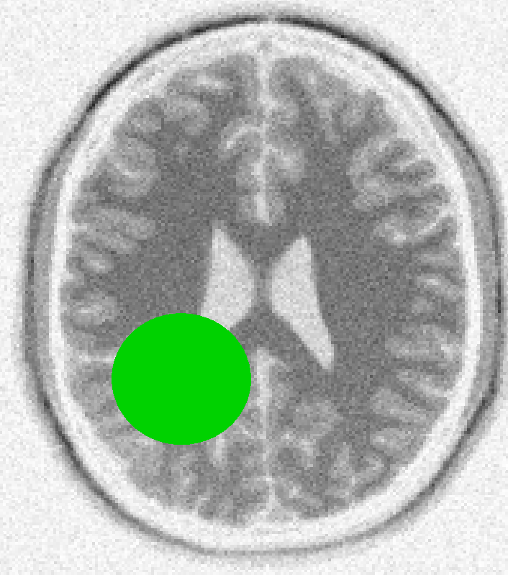
Segmentation with Level Sets
iterations
Notes:
To understand why the level set method can be slow, we should discuss how it works.
The level set method for image segmentation begins with a seed surface, which is in some sense embedded in the same space as an image.
The level set method then iteratively deforms the surface along it’s local normal according to local properties of both the surface and the underlying image.

Slide 10

Segmentation with Level Sets
iterations

Slide 11
Segmentation with Level Sets
iterations
Notes:
After many small iterations, the level set method converges on the region of interest.

Slide 12
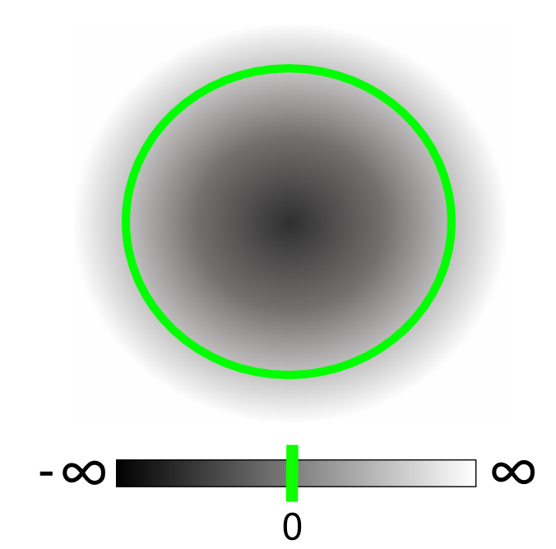
Segmentation with Level Sets
Notes:
In the level set method, we represent the surface as the zero isosurface of a discretized implicit field.
This field is initialized and maintained such that the value at a field location represents its distance to the zero isosurface.
For our purposes, it is ok if we maintain a very approximate distance field to the level set surface.

Slide 13
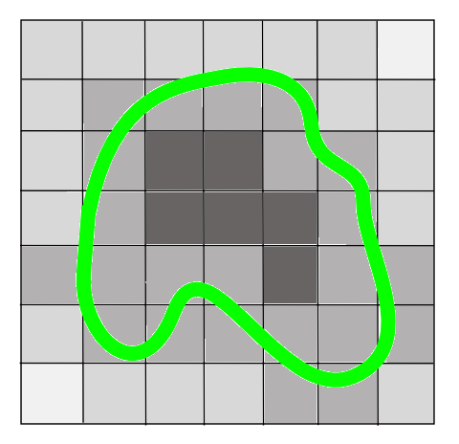
Segmentation with Level Sets
Before:
Notes:
Surface deformation occurs by updating the scalar values of fixed grid elements in the discretized implicit field.

Slide 14
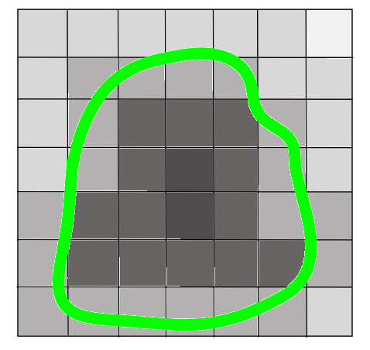
Segmentation with Level Sets
Before:
After:
Notes:
…this is in contrast to tracking the surface as a connected mesh of moving particles.
A nice property of this formulation is that topological changes in the surface are handled implicitly without any extra code. Another nice property of this formulation is that one doesn’t need to be constantly adding and removing particles to the mesh as the surface deforms. Particle-based methods are vastly complicated by conditions of extreme deformation. Representing the surface implicitly is a nice alternative to these particle-based approaches.
This formulation will be familiar to the computational fluid dynamics folks in the audience – the level set method is an Eulearian, or grid-based, simulation instead of Lagrangian, or particle-based, simulation.

Slide 15
Speed Function [Lefohn et al. 2003]
grow
image intensity
shrink
data term

Slide 16

Speed Function [Lefohn et al. 2003]
grow
curvature
image intensity
shrink
data term
curvature term

Slide 17
Speed Function [Lefohn et al. 2003]
grow
curvature
image intensity
shrink
data term
curvature term

Slide 18
Speed Function [Lefohn et al. 2003]
grow
curvature
image intensity
shrink
data term
curvature term
smoothness

Slide 19
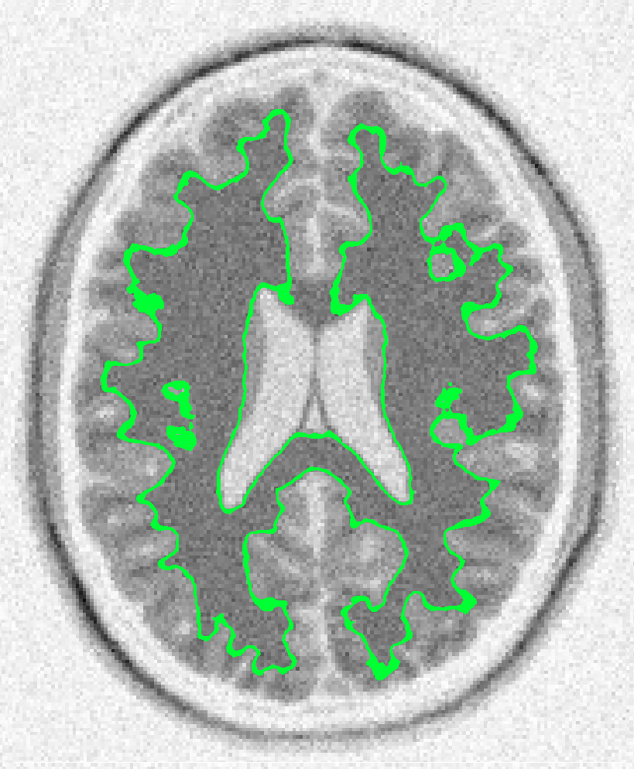

Speed Function [Lefohn et al. 2003]

Slide 20
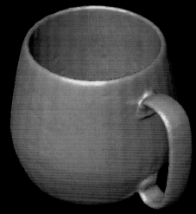
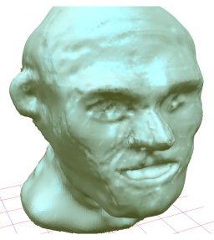
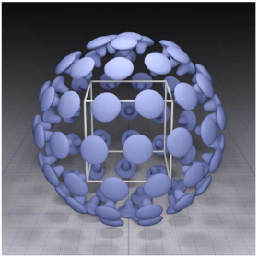
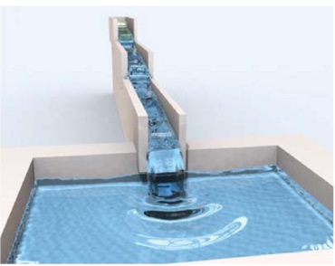

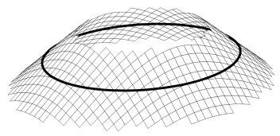
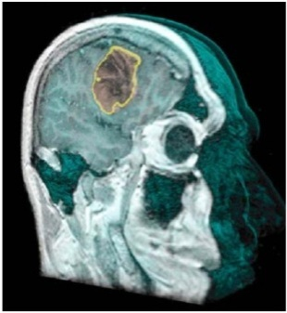
Previous Work
CPU:
Narrow Band
[Adalsteinson and Sethian 1995]
Sparse Field
[Whitaker 1998]
[Peng et al. 1999]
Sparse Block Grid
[Bridson et al. 2003]
Dynamic Tubular Grid
[Nielson and Museth 2006]
Hierarchical Run-Length Encoded
[Houston et al. 2006]
Sorted Tile List
[van der Laan et al. 2010]
GPU:
GPU Narrow Band
[Lefohn et al. 2003]
[Lefohn et al. 2004]
[Jeong et al. 2009]
Notes:
However, repeatedly updating a grid equal in size to the underlying image can be very computationally expensive…
…and there is a large body of previous work that tries to accelerate these grid updates. In the interests of time, I won’t describe this research in detail…

Slide 21
Previous Work
Common theme: leverage spatial coherence to reduce computational workload
Notes:
Suffice it to say however, that a common theme among all this previous work is that it leverages spatial coherence in the level set simulation to update the level set field in a sparse fashion.
This drastically reduces the computational workload and improves performance.
However the state-of-the-art GPU narrow band algorithm we tested still took over 100 seconds to converge on the white and grey matter in a 256^3 human head MRI.
This limitation constrains clinical applications and motivates our algorithm.

Slide 22
Our Approach
Notes:
So how do we approach this problem?

Slide 23
Our Approach
Also leverage temporal coherence to reduce computational workload
Notes:
As well as leveraging spatial coherence in the level set simulation, our approach is to also leverage temporal coherence to further reduce the computational workload…
Our goal in leveraging temporal coherence is to only update the voxels that are actually changing.
In other words, we DON’T want to spend thousands of cycles to compute an updated value, only to find out it is exactly equal to the old value.
In this case, we would prefer to put that grid element to sleep, and avoid trying to update it in the first place.

Slide 24
Necessary Conditions for Voxel to Change Value
Spatial Coherence: close to the level set surface
Temporal Coherence: local neighborhood changing over time
[Roberts et al. 2010]
Notes:
From the underlying level set equations, we derive two necessary conditions for a voxel to change value.
Roughly speaking, the first condition requires that the voxel is close to the level set surface.
This takes advantage of the spatial coherence in the level set simulation.
Previous algorithms already use this condition to constrain the computations to a small region of elements nearby the level set surface and therefore limit the computational workload.
The second condition requires that the voxel’s local neighborhood is changing over time.
This takes advantage of temporal coherence in the level set simulation.
If the voxel’s local neighborhood is not changing over time, then its value will remain constant until the local neighborhood is disturbed. We use this condition to drastically reduce our algorithm’s computational workload.
To put it another way, if previous algorithms maintain a narrow band of active elements in space, then our algorithm maintains a narrow band of active elements in space-time.

Slide 25
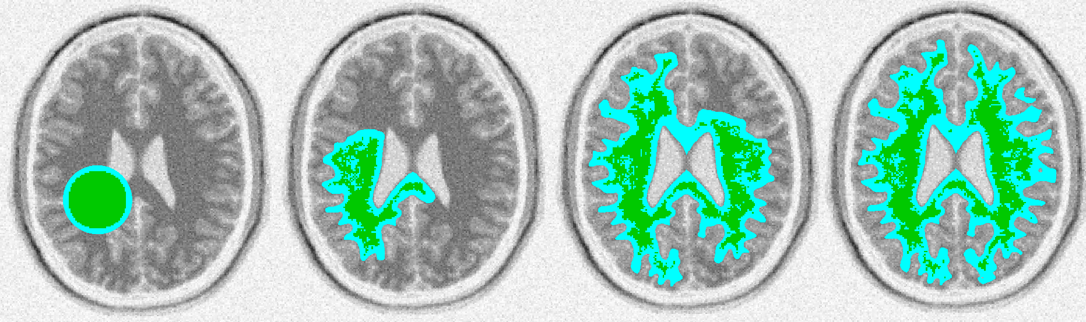
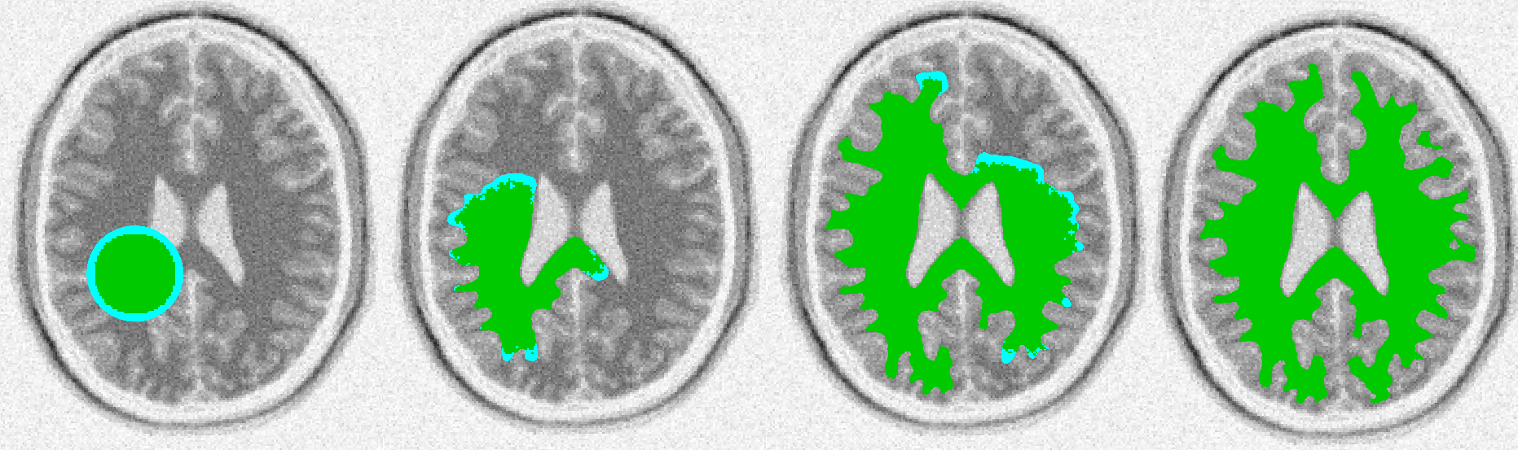
Leveraging Temporal Coherence
spatial coherence only
spatial and temporal coherence
active computation
segmented region
Notes:
This figure shows the effect of the two conditions.
On the left, we show a segmentation which takes advantage of spatial coherence only.
On the right, we show the same segmentation, but using spatial and temporal coherence to reduce the computational workload.
Areas of the level set field that are currently undergoing computation are shown in blue, and the currently segmented region is shown in green.
Less blue is better because we want to minimize the amount of computation we’re doing.

Slide 26
Leveraging Temporal Coherence
spatial coherence only
spatial and temporal coherence
active computation
segmented region

Slide 27
Leveraging Temporal Coherence
spatial coherence only
spatial and temporal coherence
active computation
segmented region
Notes:
As the segmentation progresses, we see that taking advantage of spatial and temporal coherence results in much less computation.

Slide 28
Leveraging Temporal Coherence
spatial coherence only
spatial and temporal coherence
active computation
segmented region
Notes:
When the segmentation has stabilized, we see that we can avoid all computations by leveraging spatial and temporal coherence.
If we only used spatial coherence, we would still need to perform lots of computation, even though our segmentation has completely stabilized.
This highlights an important advantage of our approach – aside from reducing the amount of computations to perform throughout the simulation, leveraging spatial and temporal coherence provides the system with a convenient and quantitative criterion for segmentation convergence.
If there are no more areas of active computation, then the segmentation has converged.
Otherwise it has not.

Slide 29
Demo

Slide 30
Temporally Coherent Algorithm
Notes:
So the high-level overview of our temporally coherent algorithm is as follows.

Slide 31
Temporally Coherent Algorithm
Initialize level set field and active computational domain
Notes:
First, we initialize the level set field and active computational domain.

Slide 32
Temporally Coherent Algorithm
Initialize level set field and active computational domain
Update level set field at active voxels
Notes:
Second, we update the level set field at active voxels.

Slide 33
Temporally Coherent Algorithm
Initialize level set field and active computational domain
Update level set field at active voxels
Voxels changing in space and time form the new active computational domain
Notes:
Third, we find the voxels changing in space AND time. These voxels form the new active computational domain.

Slide 34
Temporally Coherent Algorithm
Initialize level set field and active computational domain
Update level set field at active voxels
Voxels changing in space and time form the new active computational domain
Is active computational domain empty?
Notes:
Fourth, we check if the computational domain is empty.

Slide 35
Temporally Coherent Algorithm
Initialize level set field and active computational domain
Update level set field at active voxels
Voxels changing in space and time form the new active computational domain
Is active computational domain empty?
Yes
Segmentation converged
Notes:
If it is, then we’re done and the segmentation has converged.

Slide 36
Temporally Coherent Algorithm
Initialize level set field and active computational domain
Update level set field at active voxels
Voxels changing in space and time form the new active computational domain
No
Is active computational domain empty?
Yes
Segmentation converged
Notes:
If the active computational domain is not empty, then we return to our previous update step.

Slide 37
Initialize the level set field and active computational domain
Notes:
To clarify how exactly we initialize the level set field and active computational domain, let’s consider the following example.

Slide 38
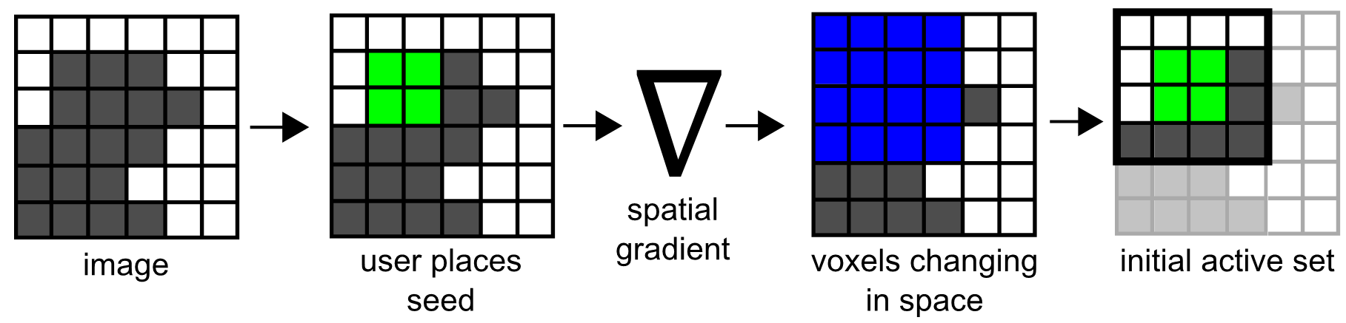
Initialize the level set field and active computational domain
Notes:
Suppose we have some greyscale image.

Slide 39
Initialize the level set field and active computational domain
Notes:
The user then places a seed surface somewhere in the level set field, shown in green in this slide.

Slide 40
Initialize the level set field and active computational domain
Notes:
From the seed surface, we figure out where the level set field is changing in space. In other words, we find where the spatial gradient of the level set field is non-zero.

Slide 41
Initialize the level set field and active computational domain
Notes:
These regions form the initial active computational domain.

Slide 42
Update the level set field at active voxels
Notes:
Next, we update the level set field at active voxels.

Slide 43
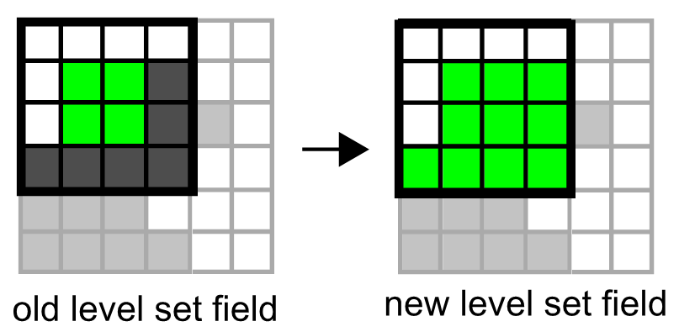
Update the level set field at active voxels

Slide 44
Update the level set field at active voxels
Notes:
This is straightforward, given that we found all the active voxels in the previous step of our algorithm

Slide 45
Voxels changing in space and time form the new active computational domain
Notes:
Now, we locate the voxels that are changing in space and time, and these voxels form the new active domain.

Slide 46
Find the voxels that are changing in space
Notes:
We break this problem up into two subproblems. The first sub-problem is to find the voxels that are changing in space.

Slide 47
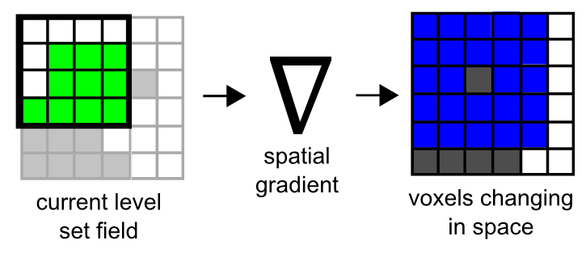
Find the voxels that are changing in space
Notes:
Given the current level set field…

Slide 48
Find the voxels that are changing in space
Notes:
we use the spatial gradient operator to locate these voxels.

Slide 49
Find the voxels that are changing in time
Notes:
Our next sub-problem is to locate the voxels that are changing in time.

Slide 50
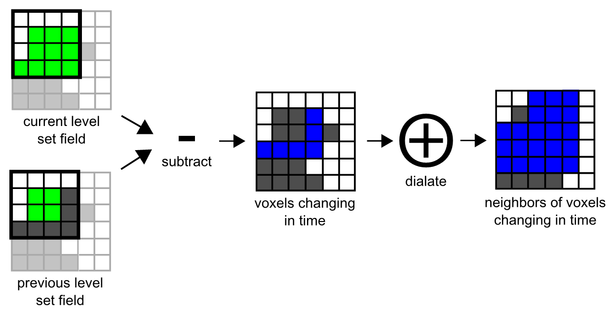
Find the voxels that are changing in time
Notes:
For this, we simply subtract the current level set field from the previous level set field.

Slide 51
Find the voxels that are changing in time
Notes:
For this, we simply subtract the current level set field from the previous level set field to get the voxels changing over time.

Slide 52
Find the voxels that are changing in time
Notes:
We dilate this set of voxels by one, because we also want to consider the neighbors of changing voxels to be active. This is because the changes in a voxel will be visible to all of its neighbors, which could potentially change the neighbor values on the subsequent time step.

Slide 53
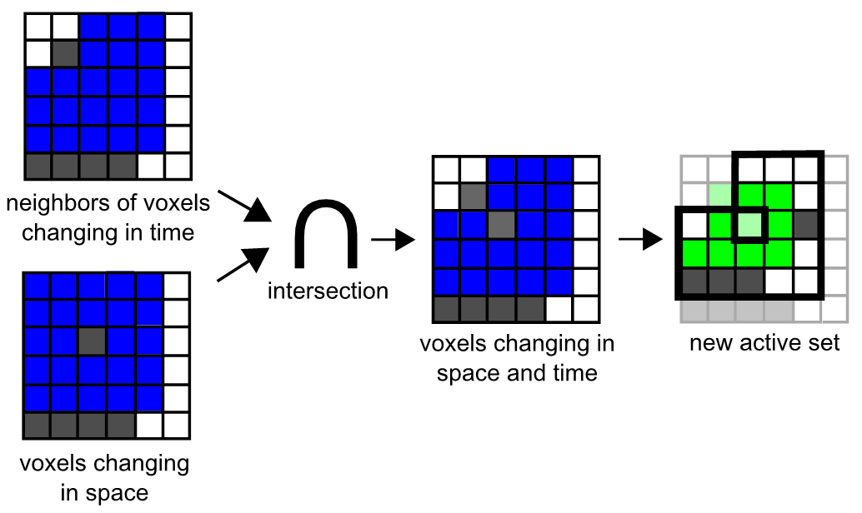
Find the voxels that are changing in space and time
Notes:
We find the voxels changing in space and time by taking the intersection of the voxels we found previously.

Slide 54
Find the voxels that are changing in space and time

Slide 55
Find the voxels that are changing in space and time
Notes:
This intersection forms our new active set.

Slide 56
GPU Algorithm
Notes:
So far we’ve defined our algorithm in terms of relatively abstract operations that are not necessarily straight-forward to implement on a GPU.
In this part of the talk, I’ll discuss how we map this high-level algorithm efficiently onto GPU hardware. By doing this, we get the nice speed-ups we want.
In turn, this enables the interactivity we saw in the demo.

Slide 57
GPU Algorithm
Intuition: efficiently maintain a dense list of active coordinates
Notes:
The intuition behind our GPU algorithm is to maintain a dense list of active coordinates, and use this list as a lookup table to sparsely update the level set field.

Slide 58
GPU Algorithm
Initialize level set field and active computational domain
Update level set field at active voxels
Voxels changing in space and time form the new active computational domain
No
Is active computational domain empty?
Yes
Segmentation converged
Notes:
Our GPU algorithm looks

Slide 59
GPU Algorithm
Initialize level set field and active computational domain
Update level set field at active voxels
Voxels changing in space and time form the new active computational domain
No
Is active computational domain empty?
Yes
Segmentation converged
Notes:
Our GPU algorithm looks

Slide 60
GPU Algorithm
Initialize level set field
Initialize dense list of active voxels
Update level set field at active voxels
Voxels changing in space and time form the new active computational domain
No
Is active computational domain empty?
Yes
Segmentation converged
Notes:
Our GPU algorithm looks

Slide 61
GPU Algorithm
Initialize level set field
Initialize dense list of active voxels
Update level set field at active voxels
Voxels changing in space and time form the new active computational domain
No
Is active computational domain empty?
Yes
Segmentation converged
Notes:
Our GPU algorithm looks

Slide 62
GPU Algorithm
Initialize level set field
Initialize dense list of active voxels
Update level set field at active voxels
Generate new active coordinates (duplicates are OK)
Remove duplicates
Compact unique new coordinates into a new dense list
No
Is active computational domain empty?
Yes
Segmentation converged
Notes:
Our GPU algorithm looks

Slide 63
GPU Algorithm
Initialize level set field
Initialize dense list of active voxels
Update level set field at active voxels
Generate new active coordinates (duplicates are OK)
Remove duplicates
Compact unique new coordinates into a new dense list
No
Is active computational domain empty?
Yes
Segmentation converged
Notes:
Our GPU algorithm looks

Slide 64
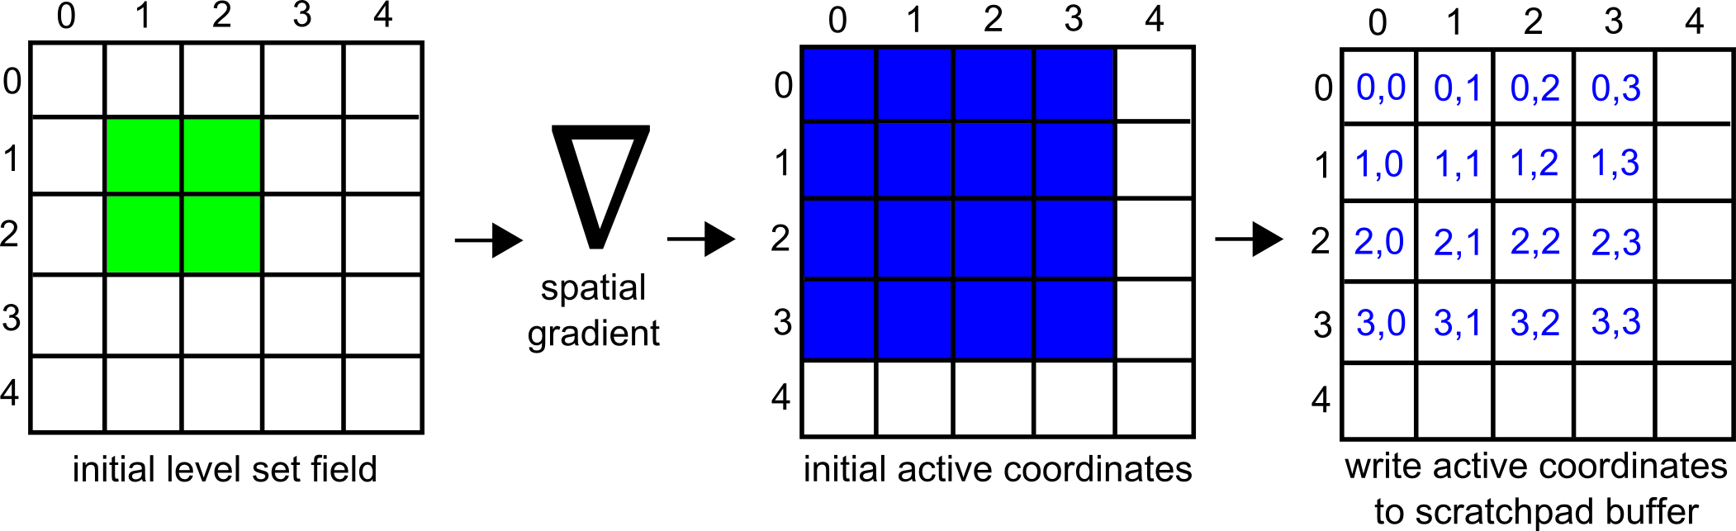
Initialize level set field and dense list of active voxels
Notes:
The first step of our algorithm is to initialize the level set field with a seed surface. This is trivial to parallelize by launching one thread per coordinate in the level set field domain.

Slide 65
Initialize level set field and dense list of active voxels
Notes:
We then apply the spatial gradient operator to the entire level set field in parallel find the voxels that are near the level set surface. This forms our initial set of active coordinates.

Slide 66
Initialize level set field and dense list of active voxels
Notes:
If a voxel is determined to be active, we write its coordinates to a scratchpad using the coordinates themselves as indices.
This seems counter-intuitive at first. After all, if I index into the scratchpad at the index (2,2), I will find the coordinate (2,2), which I already knew if indexed into the scratchpad at this location in the first place.
But we don’t know a priori which voxels will be active and we need a place for every thread to write its output data. Since we launch a parallel thread for each voxel, we simply get each thread to write to its corresponding voxel in the scratchpad.

Slide 67
Interpret scratchpad as 1D
Notes:
We then interpret the scratchpad as 1-dimensional

Slide 68
Compact the scratchpad
Stream Compaction
Notes:
And then we use the stream compaction algorithm in the open-source CUDPP library to compact the scratchpad into a dense list of active coordinates.

Slide 69
Update the level set field at active coordinates
Notes:
Once we have a dense list of active coordinates, we simply launch a parallel thread for every active coordinate to sparsely update the level set field at that coordinate.

Slide 70

Update the level set field at active coordinates

Slide 71
Update the level set field at active coordinates

Slide 72
Update the level set field at active coordinates

Slide 73
Generate new active coordinates
(duplicates are OK)
Notes:
Now that we’ve updated the level set field for an iteration, our next task is to generate a new dense list of active coordinates.

Slide 74
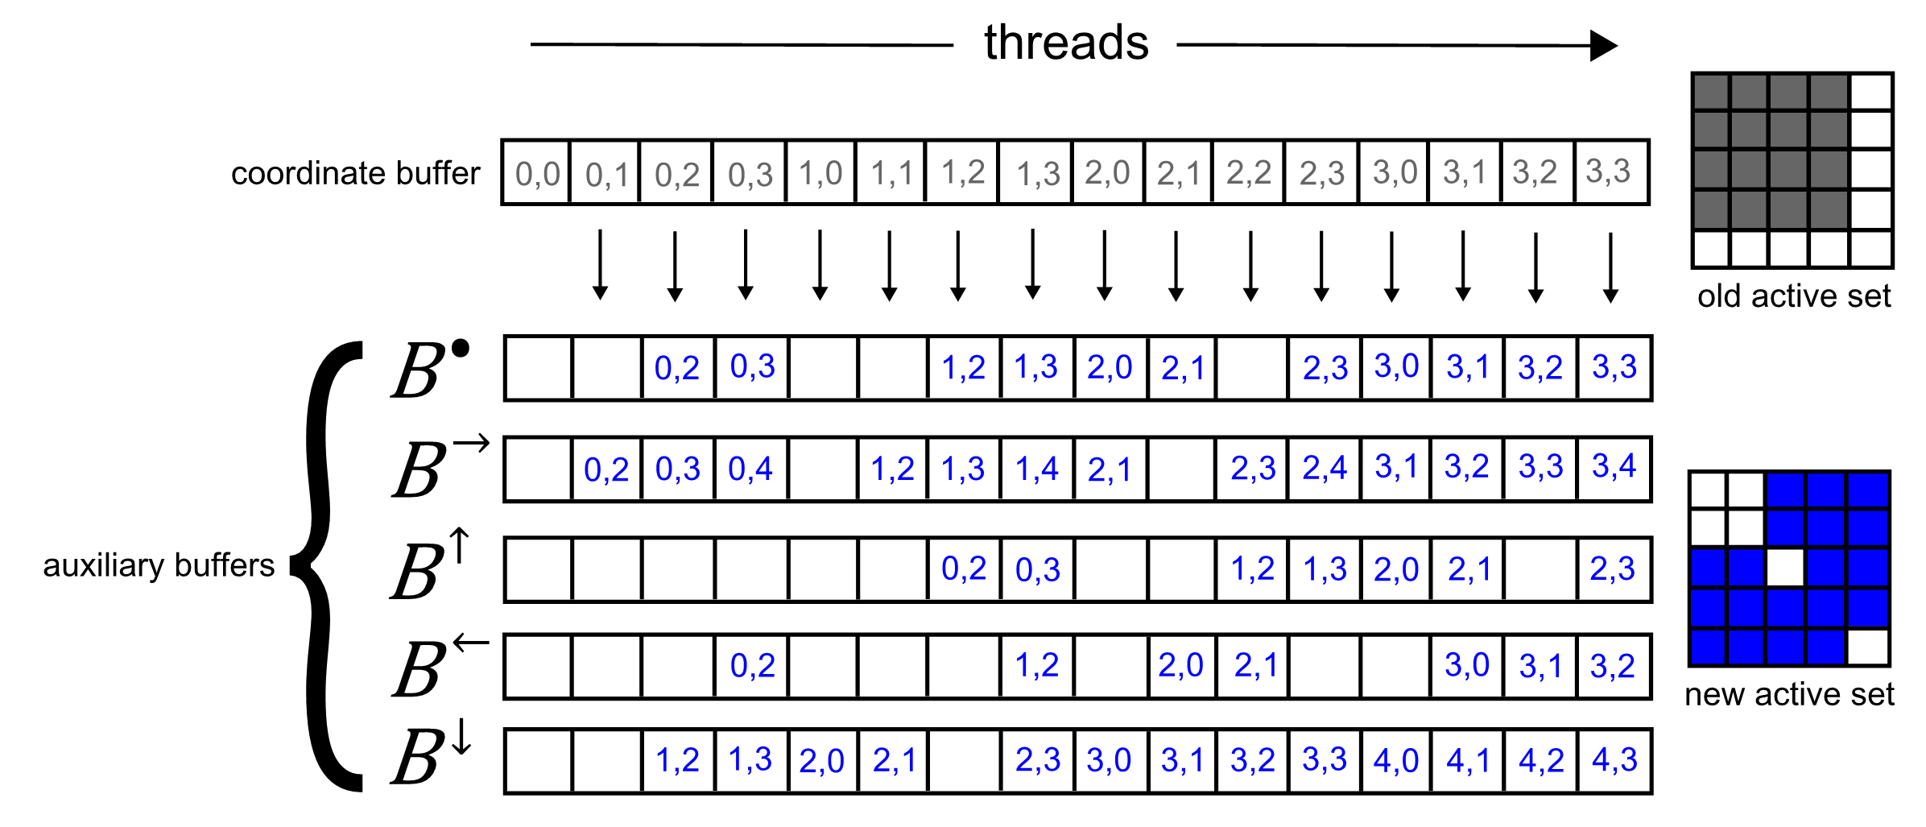
Generate new active coordinates
(duplicates are OK)
Notes:
Suppose our old active coordinates are shown in grey…

Slide 75
Generate new active coordinates
(duplicates are OK)
Notes:
…and our new active coordinates are shown in blue…

Slide 76
Generate new active coordinates
(duplicates are OK)
Notes:
To generate new active coordinates, we launch a thread for each old active coordinate. Each thread is responsible for testing the local neighborhood around one old active coordinate.

Slide 77
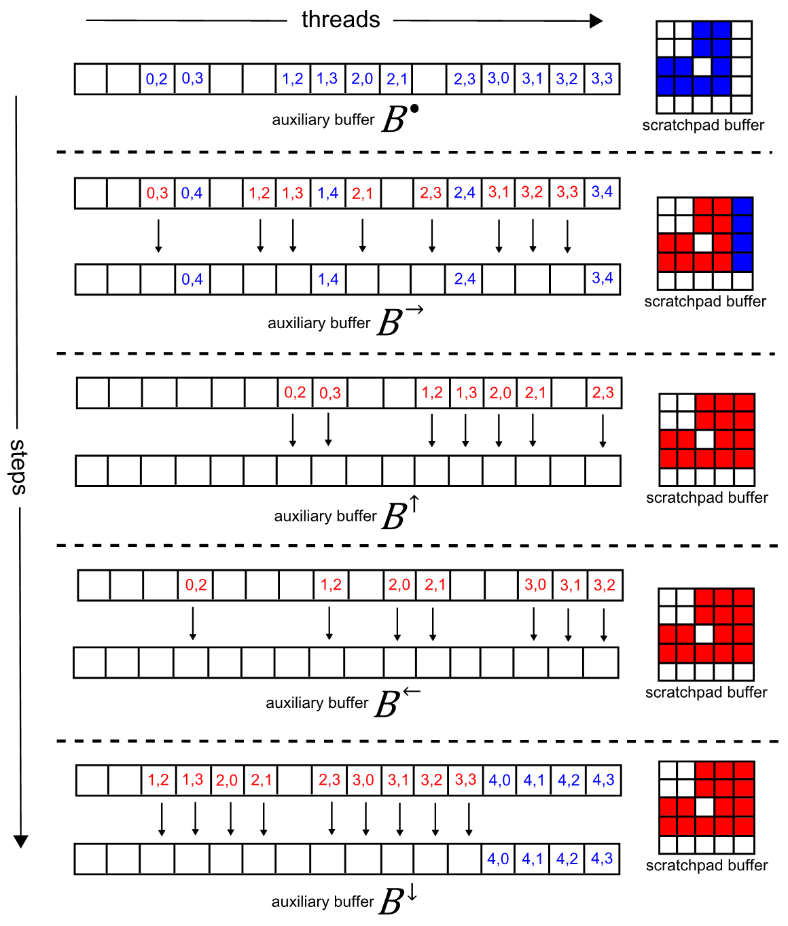
Generate new active coordinates
(duplicates are OK)
Notes:
If a coordinate is determined to be active, the thread that determined it to be active is responsible for writing it to one of several auxiliary buffers. The choice of auxiliary buffer is determined by the relative position of old active coordinate to new active coordinate. Therefore we label the auxiliary buffers according to each cardinal direction. The auxiliary buffer B-dot represents the buffer that gets used when the old active coordinate equals the new active coordinate.

Slide 78
Generate new active coordinates
(duplicates are OK)
Notes:
To examine this process in more detail, let’s look at what thread 0 would do. Thread 0 will examine the local neighborhood around the coordinate (0,0). Since there are no new active coordinates in this local neighborhood, thread 0 will not output anything to the auxiliary buffers.

Slide 79
Generate new active coordinates
(duplicates are OK)

Slide 80
Generate new active coordinates
(duplicates are OK)
Notes:
Thread 1 will examine the local neighborhood around the coordinate (0,1). As we can see from the diagram of the new active set, there is one new active coordinate in this neighborhood. This new active coordinate is the “right” neighbor of (0,1)…

Slide 81
Generate new active coordinates
(duplicates are OK)
Notes:
…since the new active coordinate is the “right” neighbor of the old active coordinate, thread 1 will write this new active coordinate to the right neighbor buffer.

Slide 82
Generate new active coordinates
(duplicates are OK)
Notes:
Thread 2 will examine the local neighborhood around the coordinate (0,2). There are three new active coordinate in this neighborhood, including the coordinate (0,2) itself.

Slide 83
Generate new active coordinates
(duplicates are OK)
Notes:
…thread 2 will write these new active coordinates to the appropriate auxiliary buffers.

Slide 84
Generate new active coordinates
(duplicates are OK)
Notes:
This process proceeds as one would expect for all remaining threads.

Slide 85
Generate new active coordinates
(duplicates are OK)

Slide 86
Generate new active coordinates
(duplicates are OK)

Slide 87
Generate new active coordinates
(duplicates are OK)
Notes:
Outputting new active coordinates in this way has a couple of nice properties. Memory accesses to each auxiliary buffer are coalesced perfectly. Moreover, since there are no duplicates among the old active coordinates, there are guaranteed to be no duplicates in each auxiliary buffer.

Slide 88
Generate new active coordinates
(duplicates are OK)
Notes:
However when taken collectively, the auxiliary buffers can, and almost certainly will contain duplicates.

Slide 89
Generate new active coordinates
(duplicates are OK)
Notes:
For example, the coordinate (0,2) appears a total of 4 times in the auxiliary buffers taken collectively. These duplicates must be subsequently removed.

Slide 90
Remove duplicates

Slide 91
Remove duplicates
global synchronization
not previously tagged → tag in scratchpad
previously tagged → remove from auxiliary
Notes:
To remove duplicates, we leverage the fact that each auxiliary buffer contains no duplicate entries. We simply tag our scratchpad in parallel at all the non-null coordinates in the first auxiliary buffer, and then impose a global synchronization point, shown in this diagram with a dotted line.

Slide 92
Remove duplicates
global synchronization
not previously tagged → tag in scratchpad
previously tagged → remove from auxiliary

Slide 93
Remove duplicates
global synchronization
not previously tagged → tag in scratchpad
previously tagged → remove from auxiliary
Notes:
For our next auxiliary buffer, we examine each coordinate in parallel. If the coordinate has been previously tagged in the scratchpad, we replace the coordinate with a null entry in the auxiliary buffer. Such coordinates are shown in red. If the coordinate has not been previously tagged in the scratchpad, we tag it in the scratchpad and preserve it in the auxiliary buffer. Such coordinates are shown in blue.
We repeat this process for each auxiliary buffer. This process is correct and free of race conditions because there are no duplicate coordinates within each auxiliary buffer. The process also has the nice property of not requiring any sorting or additional per-thread synchronization to remove all the duplicates.

Slide 94
Remove duplicates
global synchronization
not previously tagged → tag in scratchpad
previously tagged → remove from auxiliary

Slide 95
Remove duplicates
global synchronization
not previously tagged → tag in scratchpad
previously tagged → remove from auxiliary

Slide 96
Remove duplicates
global synchronization
not previously tagged → tag in scratchpad
previously tagged → remove from auxiliary

Slide 97
Remove duplicates
global synchronization
not previously tagged → tag in scratchpad
previously tagged → remove from auxiliary

Slide 98
Remove duplicates
global synchronization
not previously tagged → tag in scratchpad
previously tagged → remove from auxiliary

Slide 99
Remove duplicates
global synchronization
not previously tagged → tag in scratchpad
previously tagged → remove from auxiliary

Slide 100
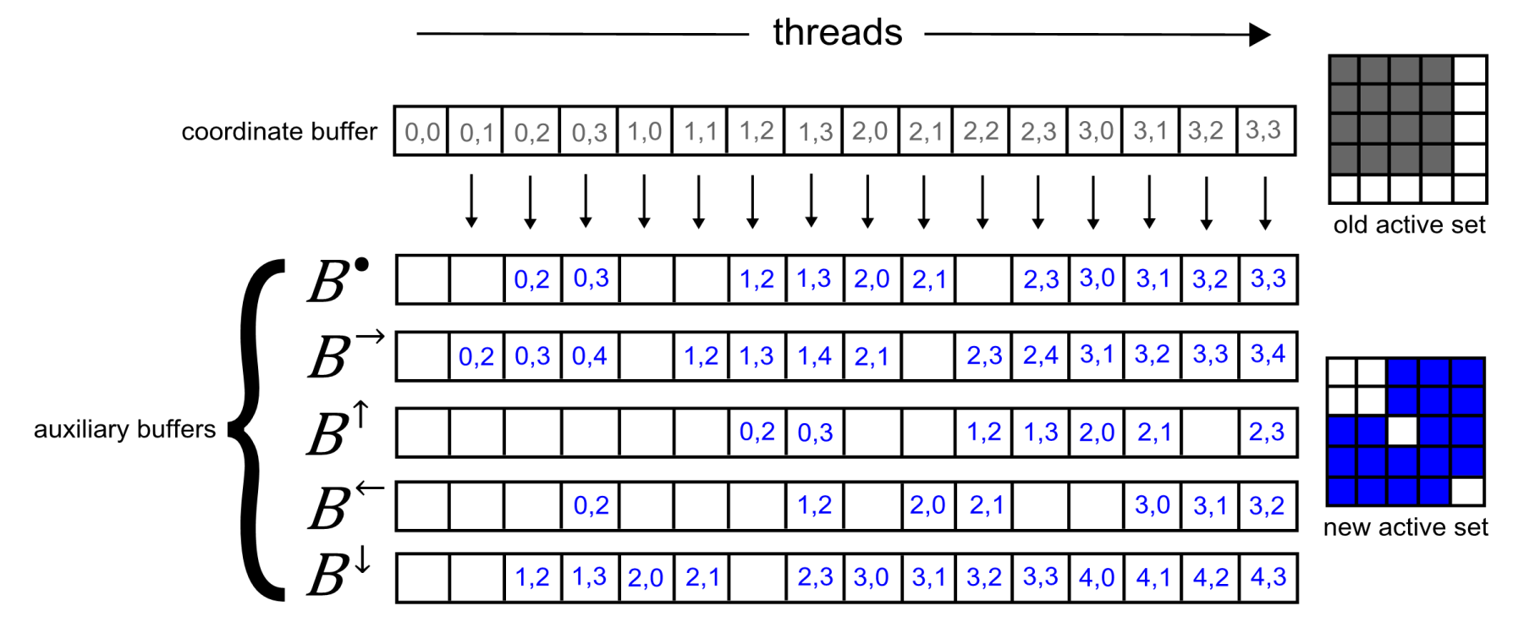
Compact the auxiliary buffers
Notes:
We use stream compaction again to produce a new dense list of active coordinates for use in the next iteration.

Slide 101
Compact the auxiliary buffers
Stream Compaction

Slide 102
Asymptotic Complexity
Previous methods: O(n) steps per level set update

Slide 103
Asymptotic Complexity
Our method: O(logn) steps per level set update

Slide 104
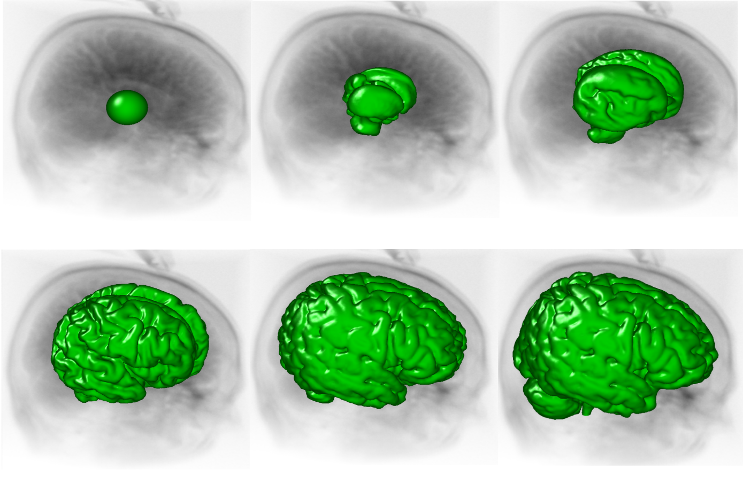
Experimental Methodology
head MRI
Notes:
To test the hypothesis that our algorithm offers improved performance without sacrificing accuracy, we repeated the segmentation shown here with our algorithm and the GPU narrow band algorithm.
We used a GTX 280 card.
We performed repeated segmentations with parametrically varying noise characteristics, and compared against the known ground-truth classification of each voxel to measure accuracy. We also measured the amount of processed voxels per iteration and the computation time per iteration.

Slide 105
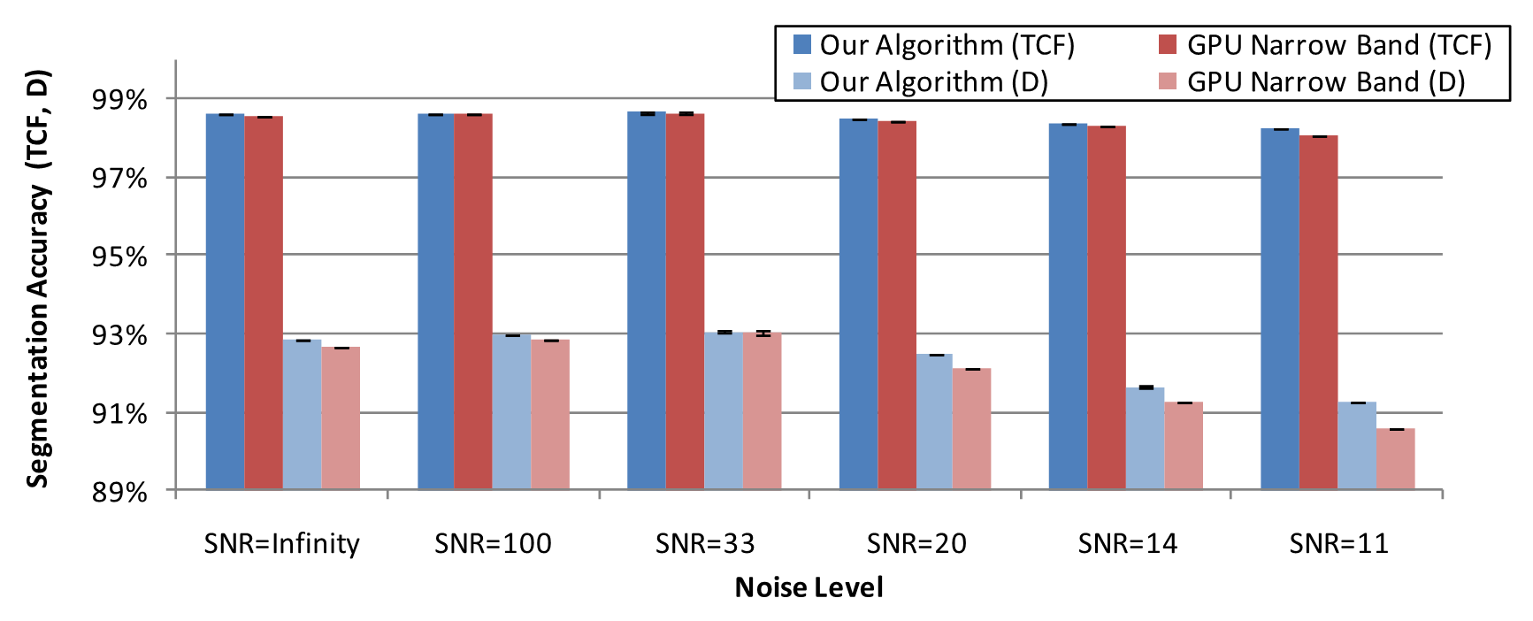
Our algorithm is slightly more accurate
SNR = Signal-to-noise Ratio
D = Dice Coefficient
TCF = Total Correct Fraction of Labeled Voxels
Notes:
This plot shows accuracy on the Y axis and noise level on the X axis. Our algorithm is shown in blue, and the GPU narrow band algorithm is shown in red. The dark colors represent the total correct fraction accuracy metric, which is more forgiving. The light colors represent the dice coefficient accuracy metric, which is less forgiving. Higher is better.
This plot shows that our algorithm has slightly higher accuracy than the GPU narrow band algorithm for all noise levels we tested. We speculate this is due to slight differences in floating point semantics between CUDA and OpenGL.

Slide 106
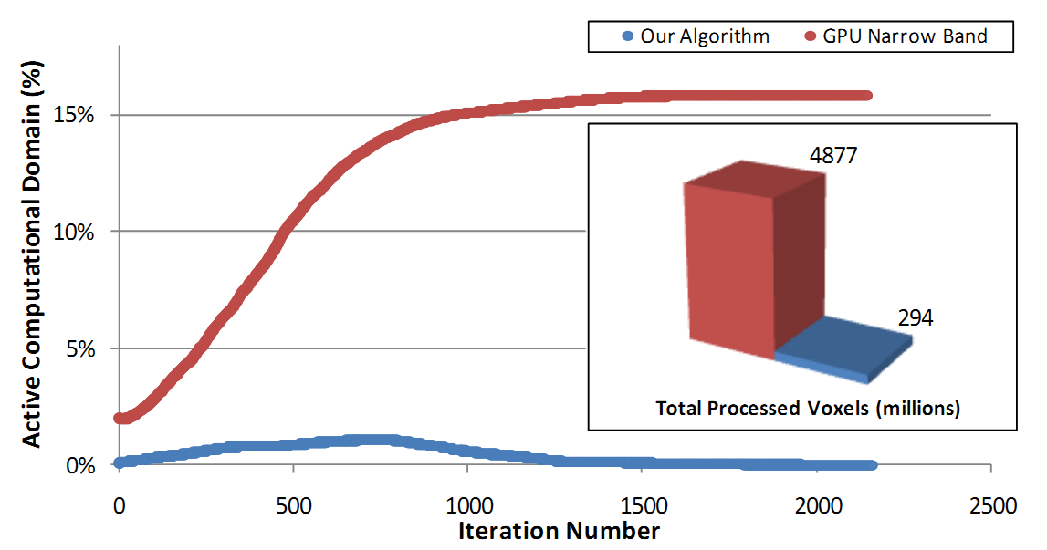
Our algorithm performs 16× less GPU work
Notes:
This plot shows the amount of GPU work (as a percentage of the total volume size) per iteration. The total amount of GPU work, or the definite integrals of each curve, are shown in the inset.
In total, our algorithm processes 16x fewer voxels than the GPU narrow band algorithm.
We see that the amount of GPU work quickly peaks and then decreases using our algorithm, whereas with the GPU narrow band algorithm, the amount of GPU work monotonically increases. This is due to our leveraging of both spatial and temporal coherence in the level set simulation. As more of the surface stabilizes, there are fewer voxels that require updating.

Slide 107
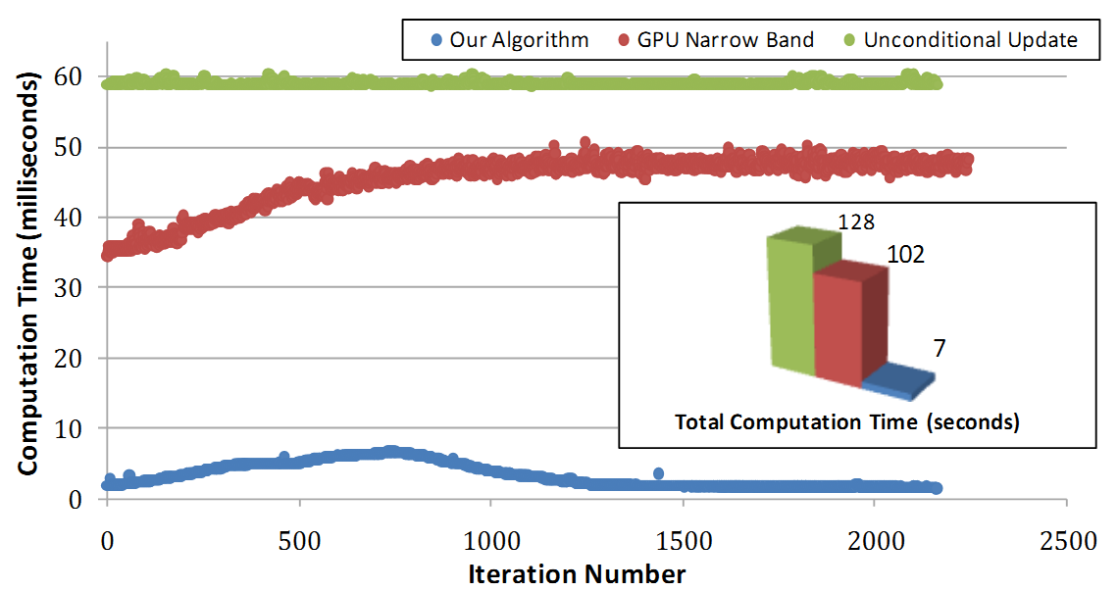
Our algorithm is 14× faster
Notes:
We see similarly shaped curves and definite integrals for the computation time per iteration.
Our algorithm is 14x faster than the GPU narrow band algorithm. Moreover our algorithm gets faster over time in contrast to the GPU narrow band algorithm which gets monotonically slower over time.
To provide additional context, a CUDA level set solver that unconditionally updates every voxel during every iteration is shown in green.

Slide 108
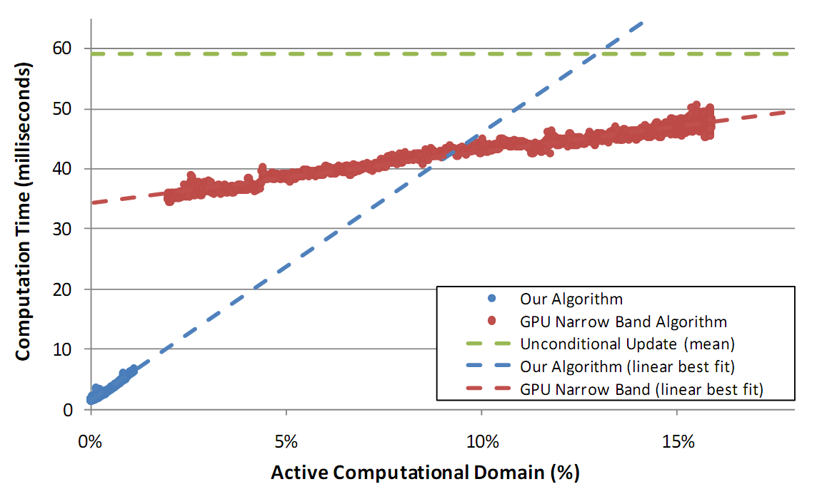
Linear relationship between computation time and GPU work

Slide 109
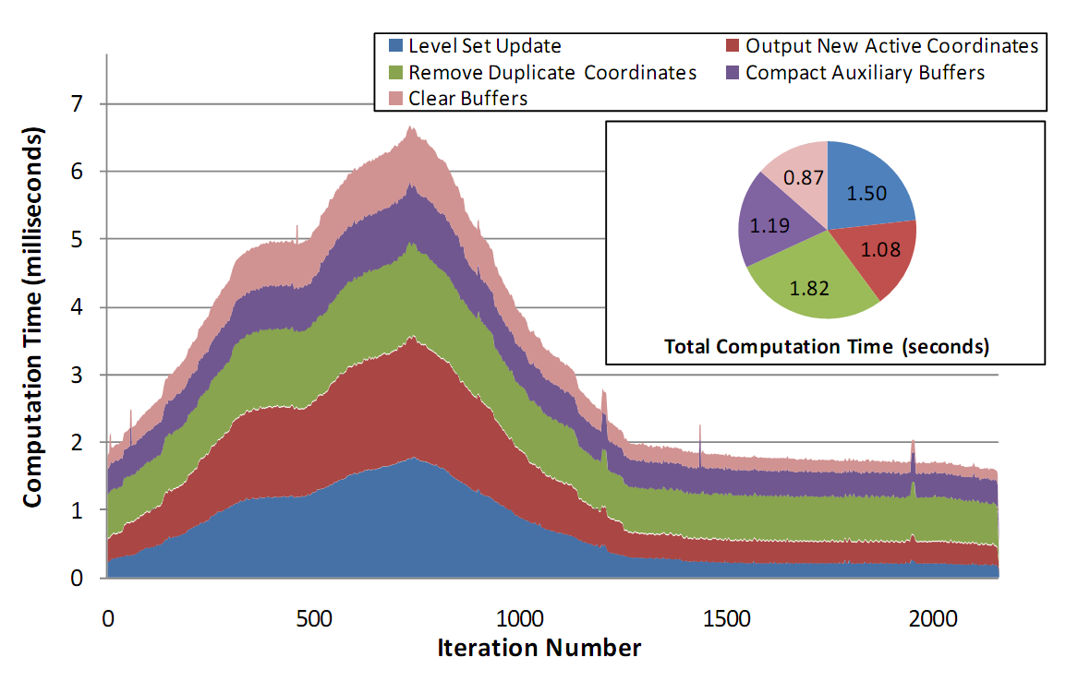
Most time is spent updating our sparse data structure

Slide 110

Results
abdominal CT
Notes:
Here are some additional results from our system. This is a segmentation of the aorta and kidneys in an abdominal CT data set.

Slide 111
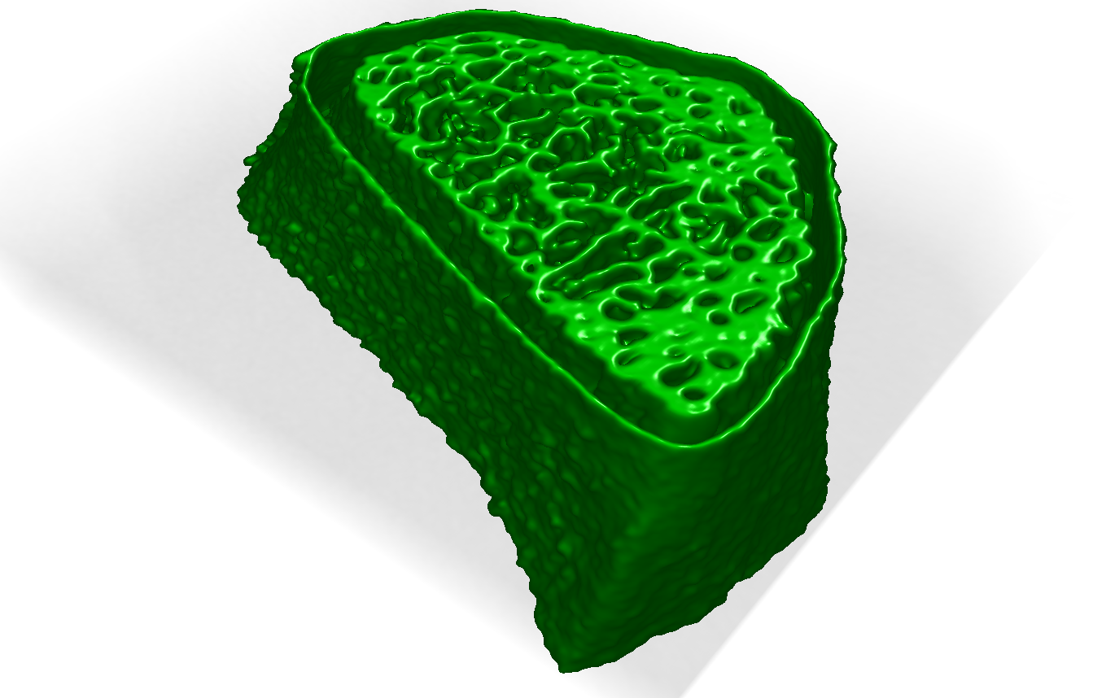
Results
wrist CT
Notes:
This is a segmentation of the cortical and trabecular bone in a high-res wrist CT image.

Slide 112
Goals: fast, interactive, accurate
Notes:
Given the results of these experiments, we have achieved our goal of fast, interactive, and accurate segmentations.

Slide 113
✓
Goals: fast, interactive, accurate

Slide 114
✓
✓
Goals: fast, interactive, accurate

Slide 115
✓
✓
✓
Goals: fast, interactive, accurate

Slide 116
✓
✓
✓
✗
Goals: fast, interactive, accurate
, compact
Notes:
Requires a large amount of GPU memory
About 500 MB for a 256x256x256 data set
Scaling to high order neighborhoods increases memory requirements
Need extra auxiliary buffers
Increases redundant work per thread

Slide 117
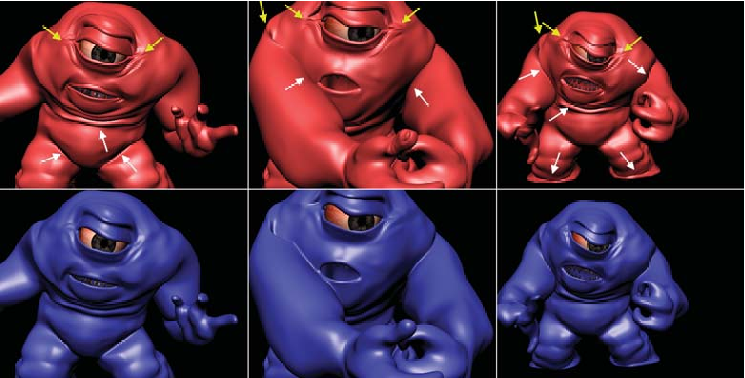
“overall memory consumption proportional to the area of the geometric surface”
Hierarchical RLE Level Set: A Compact and Versatile Deformable Surface Representation
[Houston et al. 2006]
Notes:
Reduce the memory requirements
Implement sparse representation of the level set field and other buffers (i.e. hierarchical run-length-encoded level sets) on the GPU

Slide 118
“overall memory consumption proportional to the area of the geometric surface”
“fast sequential traversal with O(1) access time to elements”
Hierarchical RLE Level Set: A Compact and Versatile Deformable Surface Representation
[Houston et al. 2006]
Notes:
Reduce the memory requirements
Implement sparse representation of the level set field and other buffers (i.e. hierarchical run-length-encoded level sets) on the GPU

Slide 119

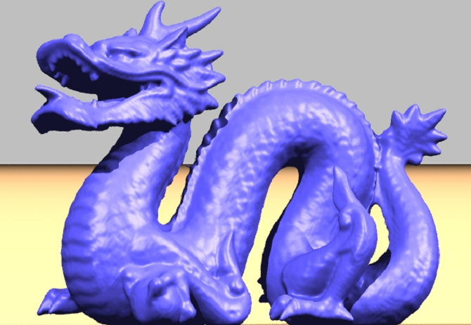
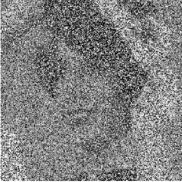

[Losasso et al. 2008]
[Zhao et al. 2001]
[Darbon and Sigelle 2006]
?
Notes:
Applicable to other level set problems in computer graphics?
Fluid simulation, surface reconstruction, image restoration, etc
Are there other applications for the duplicate removal algorithm?

Slide 120
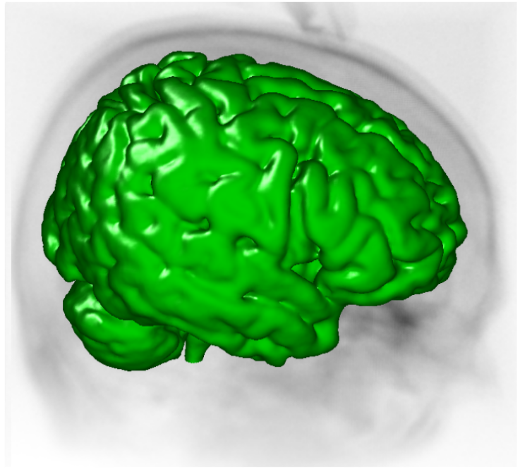
?
A Work-Efficient GPU Algorithm for Level Set Segmentation
Mike Roberts, Jeff Packer, Mario Costa Sousa, Joseph Ross Mitchell
High Performance Graphics 2010
Notes:
And with that, I’d like to turn it over for questions. Thanks so much for listening, and please do check out our HPG paper for more details.
Cheers.

Slide 123
Bonus Slides

Slide 124
What do I mean by work-efficient?

Slide 125
What do I mean by work-efficient?
O(parallel work) = O(sequential work)

